Slide 2


Slide 3
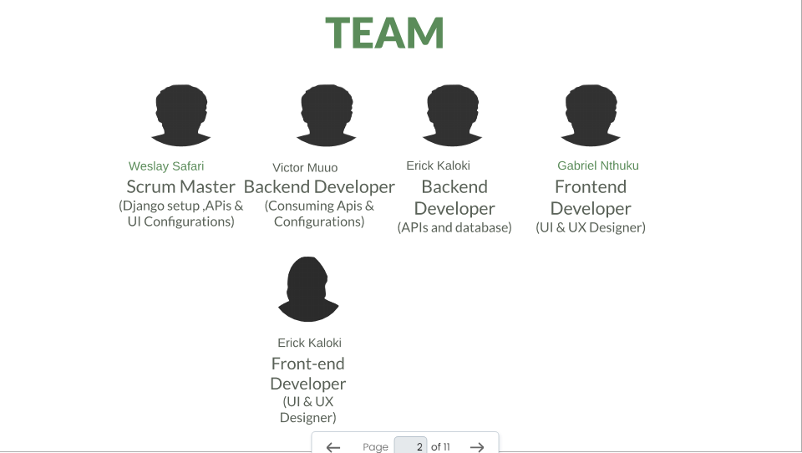

Slide 4
Problem statements
One of the problems Machakos County has is :-
Limited Access to Quality Education:
EduLand provides a platform that offers online and offline learning resources in software engineering and technology in agriculture.
We aim to collaborate with local educational institutions to develop and deliver relevant courses and training programs to people of any age

Slide 5
EduLand is an innovative online learning platform committed to transforming education in Machakos County. Building upon our success in bridging the gap between fast pacing technology trends and traditional learning in STEM and Agriculture, we are excited to introduce a new initiative focused on empowering youth and farmers through technology-based skills training.

Slide 6


Slide 7


Slide 8
Key Features Of EduLand
Learing Moudules
Community Forums
Discussion boards for learns to engage with peers and mentors
Profile and interviewss with local tech professionals and entreprenuers
Resources on startup and running a tech business

Slide 9
Product Characteristics and Requirements : 1. Secured database.(Data security & privacy) 2. User progress tracking 3. Search feature 4. Scalability 5. Customizability 6. Interactivity & Engagement 7. Assessment & feedback 8. Content management

Slide 10
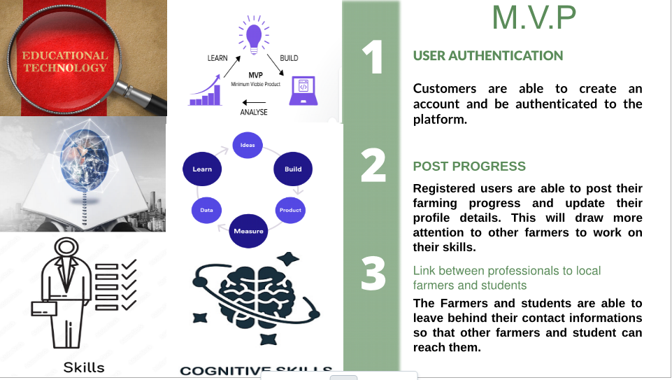

Slide 11
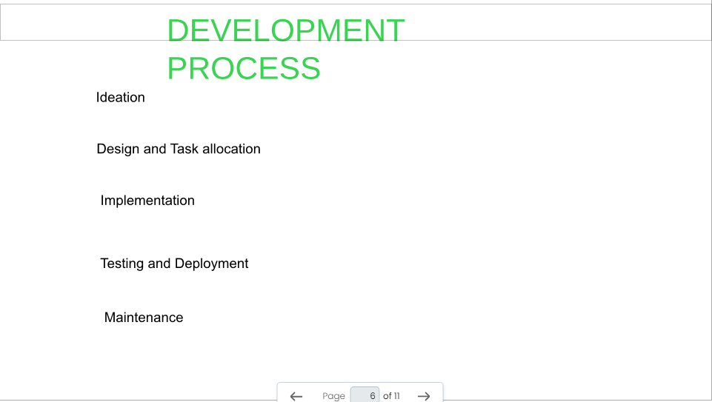
https://www.figma.com/file/8uUZNY1cf6DGsY92JPCml8/EduLand?type=whiteboard&node-id=0%3A1&t=fPmVFCxgLDEDVkMA-1
https://www.figma.com/file/RrXalQY974HgDZAa1TDD0l/Eduland?type=design&node-id=0%3A1&mode=design&t=JOim7UZ0tNoaM3fl-1

Slide 12




Slide 13


Slide 14


